Slide 1
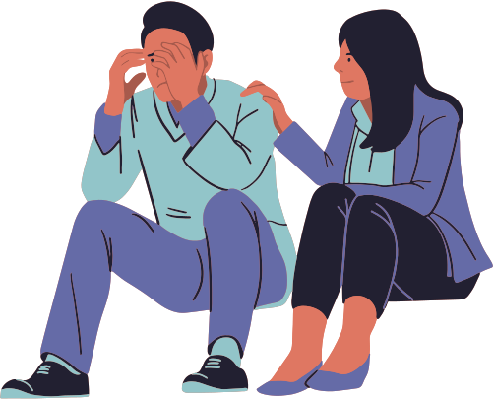
AARNA : MENTAL WELLBEING
Team name : Mighty Minds
College Name : Baderia global institute of engineering and management , jabalpur
Team member: Prashu Jain
Roshan Sen

Slide 2
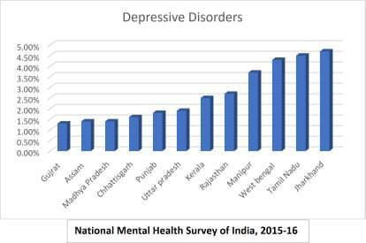
THE PROBLEMS
Mental health problems are very common. In a single week, at least one in six of us has problems with our mental health .
They include the painful feelings and thoughts that we all have at times – including periods of sadness, hopelessness and fear.
Many people suffer from more than one mental disorder at a given time.
While major depression can develop at a
any age, the average age at onset is the mid-20s.
The highest suicide rates in the U.S. are found in Caucasian men over age 85. However, suicide is also one of the leading causes of death in adolescents and adults ages 15 to 24.

Slide 3
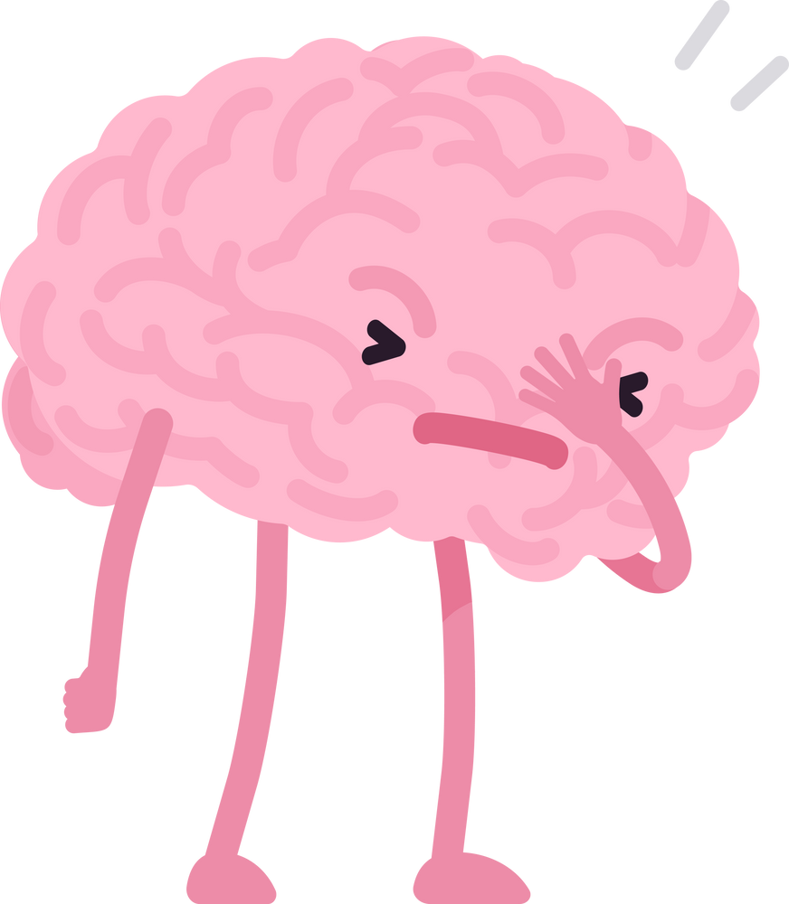
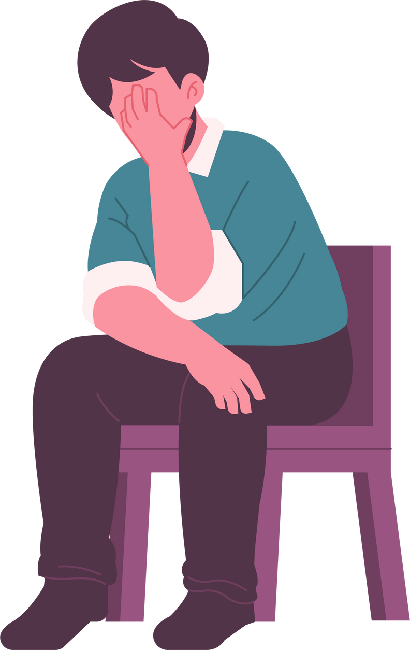
PROBLEM STATEMENT
Self identifying mental health status and get
guidance for support.

Slide 4
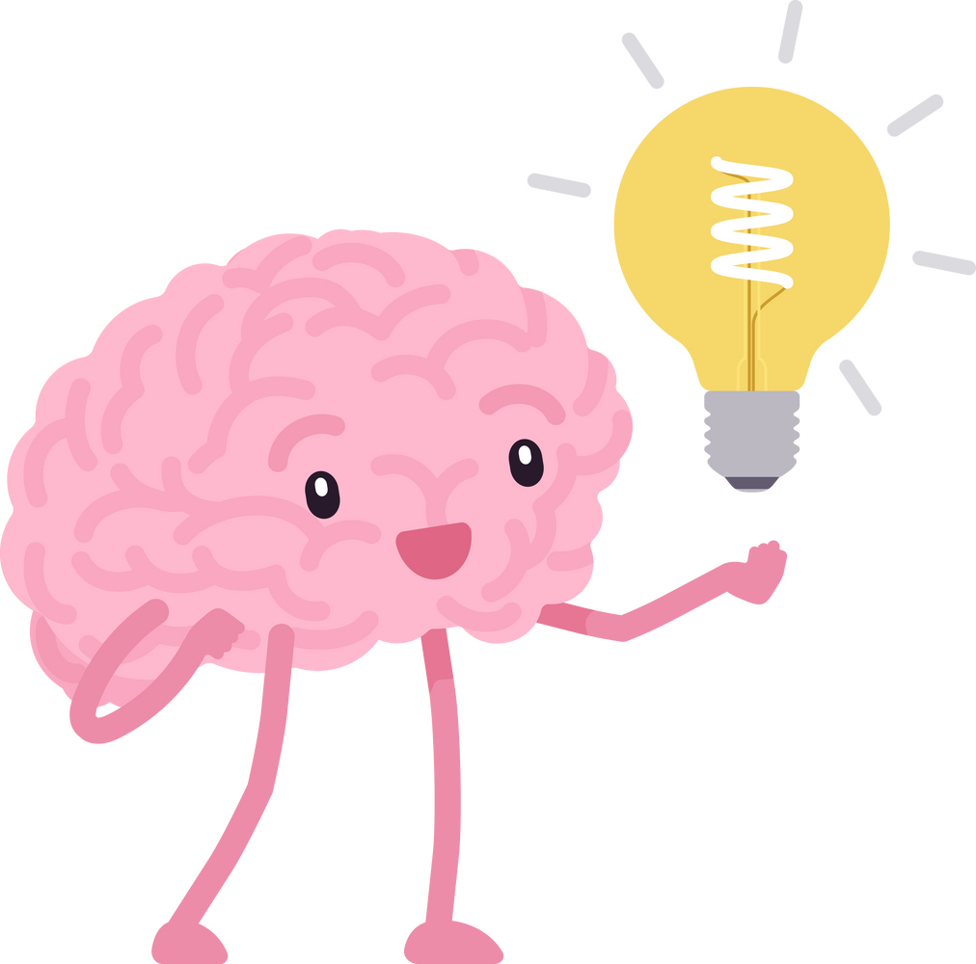
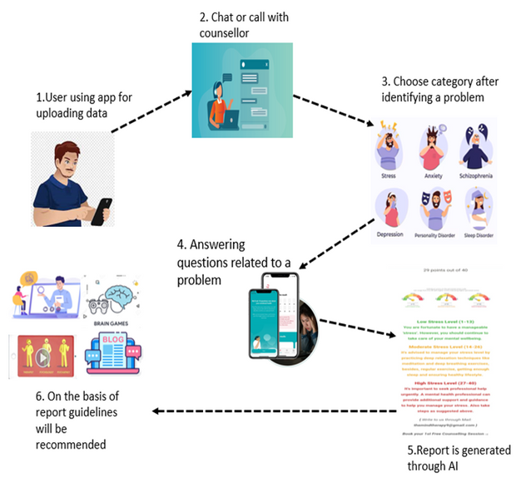
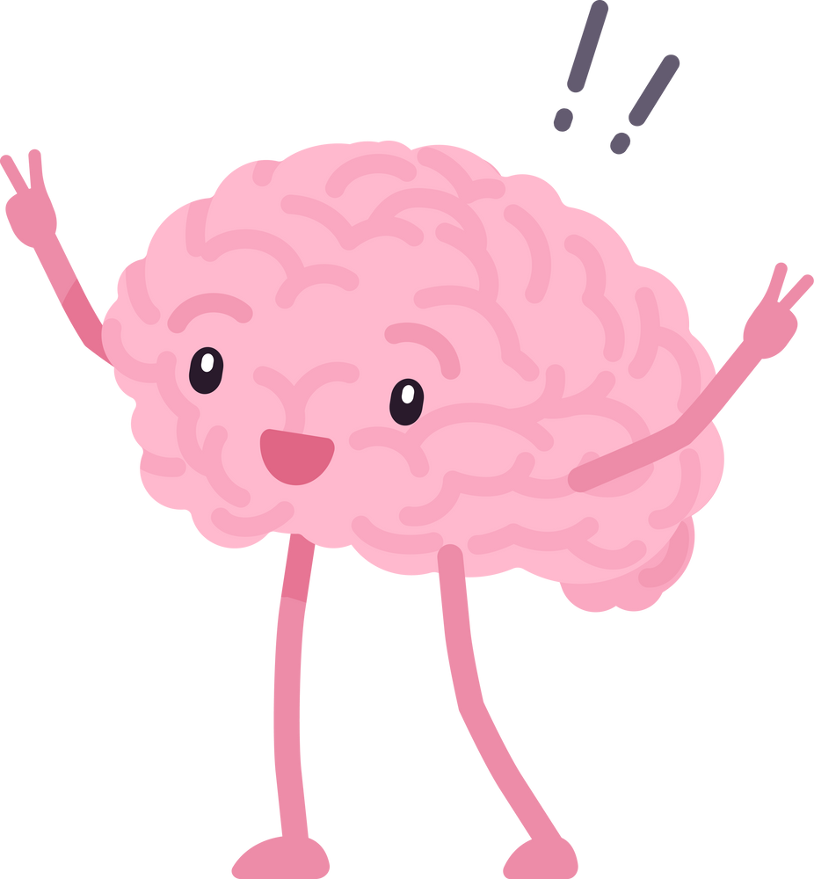
SOLUTION
This application will be taken into interest the problems regarding mental health issues such as depression , anxiety , stress , bipolar disorder etc .
Where in , through this web application people will be able to identify their problems for a particular mental condition and will get to know what’s the exact problem they are facing and what precautions must be taken to cure themselves , and people can also connect to peers for more convenience .

Slide 5
After login/signup process , a user will have two options for one-to-one conversation : 1. Chat with counsellors through AI , 2. Call with counsellors regarding the problem a user is facing .
Once , the user is able to identify the problem through a counsellor , the user will get categories option where they will choose the category (such as depression , anxiety, stress , bipolar disorder etc). After selecting the particular problem , user will have several questions regarding those problems which help them to identify the current mental stage of their condition .
After analysing the condition , A report is generated through AI .
Report is analyzed and level of condition is checked on the basis of User’s score which is defined by the total numbers of questions asked . User’s score will show the severe condition , intermediate condition and normal condition of the user which will be generated through AI .
After report is checked , for intermediate and normal conditions blogs , neurological games and therapy videos are available and for severe condition consultations with the psychiatrists and neurologists , peer-to-peer connections and group sessions will be available .

Slide 6

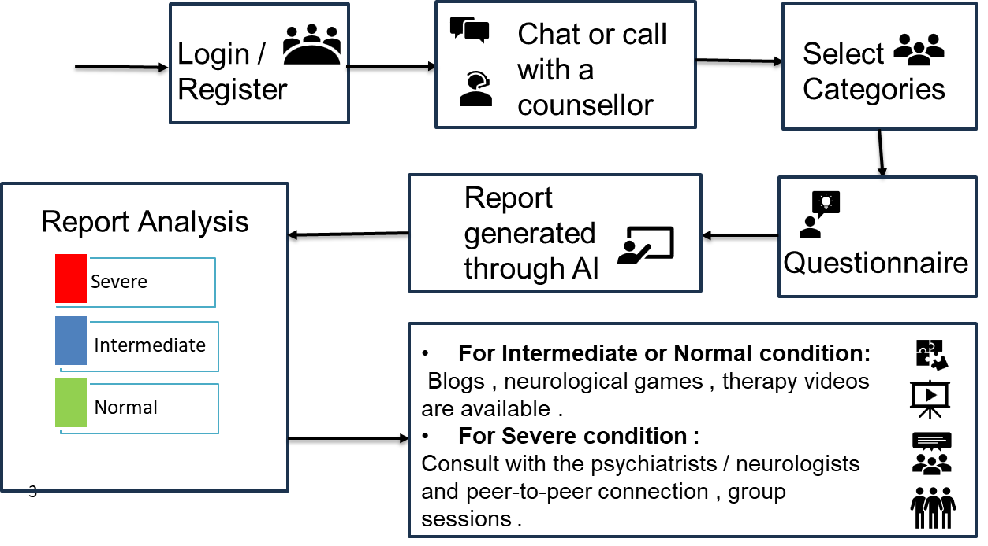
WORKING APPROACH

Slide 7

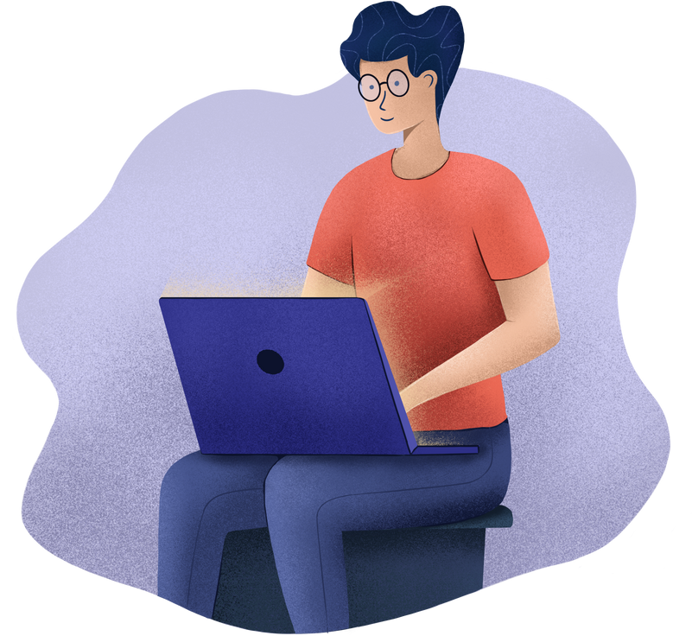
TECHNOLOGY STACK
Frontend : HTML , CSS , JAVASCRIPT , React
Backend : Node.js (Express.js) , WebRTC (video conferencing)
Database : MySQL
Artificial Intelligence , APIs

Slide 8

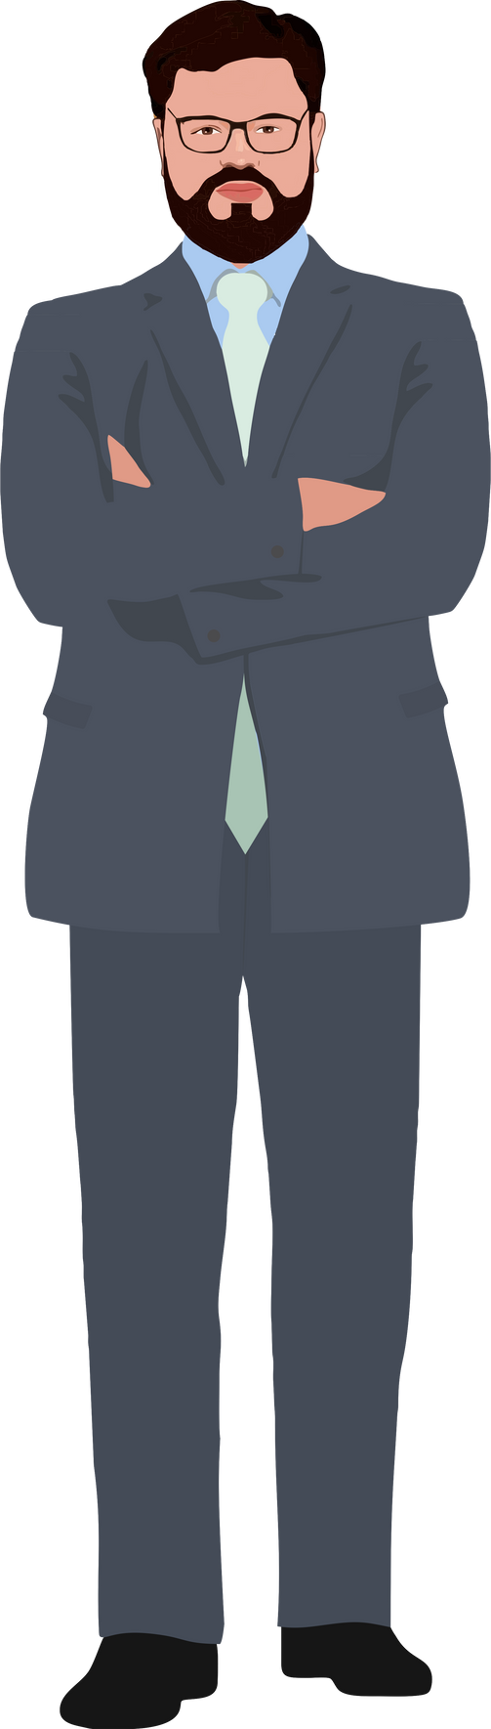
THANK YOU

